Slide 1
The Green Gas Mileage Calculator: Sprint One Retrospective
A presentation by the members of 45mph (Group 45)
Notes:
Kieran: Welcome everybody to the second presentation of 45mph. Today we will be covering the progress made on our application during the first sprint and our plans for continuing work into the second.

Slide 2
45mph is now…
Name | Role | Initials
CW Ellis | Project Manager | CW
Rahul Chari | Scrum Master | RC
Kieran Ford | Development Team Member | KF
Notes:
Kieran: Before we begin, we must report that the team has lost a member since the completion of the planning and design presentation, in fact he announced to us that he would be leaving right after we gave that presentation. This necessitated many changes to our product backlog to compensate for the fact that the three-person team could not complete as much work as the four-person team, including a reduction in our product’s scope.
Though we are sorry that this was necessary the group also realizes that reducing the total number of features in response to one member leaving will allow the remaining members to focus on the remaining product backlog items and hopefully deliver a better product.
To illustrate what we mean, CW Ellis will now speak about the revised product backlog and Rahul can log the work completed during the first sprint.

Slide 3
Removed Features
Feature/Story | Pts. | Sprint
Maps API | 26 | 1
Digital Odometer | 11 | 1
Driving Suggestions | 25 | 2
Total Points Excluded: | 62
Notes:
Christopher: Thanks, Kieran. After consulting with Dr. Thomas, we decided soon after the planning and design presentation to regroom the product backlog, revising our sprint schedule and removing a few features, which are listed above.
In particular we decided to remove our application’s dependence on Google Maps and the associated APIs. To facilitate the separation from these dependencies a couple changes have been initiated in the user experience, but we at 45mph hope that they will in fact mean performance and convenience benefits for the application
First, the user will no longer have to remember to start the trip or take the unnecessary risk and inconvenience of pulling over if they do. Instead, they simply record the distance driven using their vehicle’s odometer along with its fuel consumption at the trip’s end rather than relying on an automatic odometer system. This makes the application more convenient for the consumer because they would have had to manually report fuel consumption anyway and now they don’t have to start the trip to record it.
Finally, without Maps and no longer recording data during trips, driving suggestions are no longer possible for the user.
Though these features would have seemed attractive in the final product, we felt that the convenience of not needing to remember to record trips at the start and the easing of development that these changes would provide would make the application more feasible in the time we are given to develop it. In particular, the team no longer has to configure the API calls required by the Maps functionality and we no longer have to program the artificial intelligence necessary for generating driving suggestions.
That in mind, we excluded 62 story points from our original product backlog and formed a new sprint schedule, which is available on the next slide.

Slide 4
Revised Sprint Schedule
Sprint 1
Sprint 2
Feature/Story | Pts. | Assigned
UX Design | 27 | RC, CW, KF
Fuel Cost Calculator | 9 | KF
Fuel Consumption Logs | 4 | CW
Hypothetical Buyable Fuel Calculator | 7 | CW
Hypothetical Fuel Cost Calculator | 7 | KF
Total: | 67 | 13 cross-sprint pts.
Feature/Story | Pts. | Assigned
Environmental Impact Tracking | 12 | RC, CW
Gas Mileage Calculator | 3 | CW
Implement Vehicle Profiles | 10 | CW, KF
Maintain Data Logs | 23 | RC, CW, KF
Personalized Reports | 12 | RC, CW
Total: | 63 | 3 cross-sprint pts.
Required Velocity Estimate: 65 pts/sprint
Capacity Estimate: 72 hrs/sprint
Notes:
Christopher: And here is that revised sprint schedule. In total, we removed 37 points from the first sprint and 25 from the second, bringing the two sprints to just about a just about even number of story points each. Further, our estimate for the required velocity dropped from almost 100 pts per sprint to just 65; and the team lowered their capacity estimate in response to increasing demands in other classes and the fact that we were already offering more hours than expected for the assignment. Now, each of us plans to put in about 12 hours a week instead of 14.
Remember also that the point totals in these tables, which are adjusted versions of those appearing in our planning and design presentation, are adjusted for the cross sprint points in the lower right of both.
With this introductory explanation of our team’s changing plans out of the way, Rahul can now relate to the work we have done in the past two weeks in reference to our sprint schedule.

Slide 5



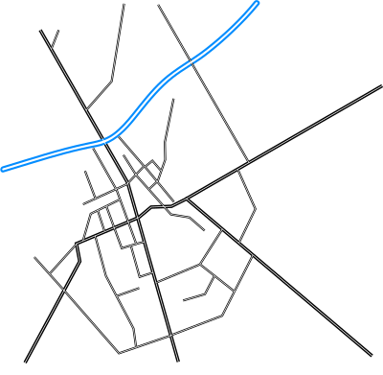


Work Completed
UX Design (22/27 pts)
Fuel Cost Calculator (6/9 pts)
Trip Records and Logs (10 pts)
Hypothetical Buyable
Fuel Calculator (4/7 pts)
Hypothetical Fuel
Cost Calculator (4/7 pts)
Vehicle Profile Creation (5 cross-sprint pts)
Notes:
Rahul: During Sprint 1, we implemented all of our menus and buttons for the UX design, integrating most of the features into their respective pages. Since we have not yet implemented our Sprint 2 features, we cannot mark this PBI as fully complete. We devised functions to calculate fuel cost, hypothetical fuel cost, and hypothetical buyable fuel; the remaining unfinished points in these calculators sections come from difficulties we’ve had in implementing automatic data entry**not doing this anymore. We fully implemented logging and storing user trip records in local memory. Finally, we developed a mechanism that allows users to select the vehicle that will be used for recording trips.

Slide 6
Productivity Statistics
Percentage of Work Completed
51/67 = 76.1% of sprint one story points completed
51/130 = 39.2% of the total story points completed
Actual Velocity
51 pts/sprint (14 pts/sprint less than Required Velocity Estimate)
Projection into 2nd Sprint
At this rate, the team will be able to complete 102/130 = 78.4% of our total backlog
Remarks
1. Our team can adapt in the future
2. Work completed statistics may understate actual progress
3. Story Point Estimates are just that
Notes:
Rahul: Our completion of sprint one offers new insights into our productivity. First, we see that we completed about 76 percent, approximately 3/4, of the work expected for this sprint, meaning that just about 39 percent, about 4 out of 10, total story points have been completed.
Our actual velocity is fittingly about 4/5 of the estimate of required velocity estimate, leaving 14 of the 65 expected points on the table.
If we project these numbers into the second sprint, then we will complete 102 points or also about 3/4 of the total product backlog.
Clearly, if this continues, there will probably be work left on the table when we ship this product in mid-November, but we believe that the team can make adjustments and will be able to complete work more efficiently during the second sprint than the first, as a result with becoming more familiar with Android Applications, Android Studio and the TDD design process.
Further, we must understand that measuring progress using completed story points, although convenient and part of our rationale to use them in the first place, may understate our progress in this case because several points were given up as part of new design decisions, such as the ones for automatic data display, or that we realized could not be completed until sprint 2, like the Menu Integrations. These two categories add up to 14 of the 16 points that were missed in the second sprint.
On the other hand, we also remark that the second sprint contains more advanced features, such as calculating the users environmental impact, that may be more difficult to implement put which also largely rely on our existing code base. As a result, the story point estimates are just what they say they are, because the actual work required to complete a task may or may not be reflected by them.

Slide 7
Sprint 2 Backlog
Feature/Story | Pts. | Assigned
Environmental Impact Tracking | 12 | RC, CW
Gas Mileage Calculator | 3 | KF
Finish Implementing Vehicles | 10 | CW, KF
Maintain Data Logs | 21 | RC, CW, KF
Personalized Reports | 12 | RC, CW
Integrate all features into their respective Menus | 5 | CW
Implement time-based fuel usage filter | 3 | RC
Total: | 66
Notes:
Rahul: Nonetheless, with what we’ve learned from the first sprint and with the items left from the first sprint to carry over into the second, we are able to rewrite our backlog for the second sprint. Here, we see we have 66 story points in total, consisting of the features that make our application unique. We also made a few changes to story assignments in order to evenly balance the work distribution between the three of us. Considering our previously mentioned capacity of 72hr/sprint, we will be able to complete all items in our new Sprint 2 backlog by the end of the next sprint.

Slide 8


Test-Driven Development
First
Then
Notes:
Kieran: But before we close our discussion of the application’s development and show off the fruits of our labor, something has to be said for TDD. In this class we are expected to implement the Test Driven Development (or TDD) process while working on our project. That is, we are expected to write tests that fail and then the code to pass those tests, rather than testing last; and this team has made sure to do so and log that fact.

Slide 9
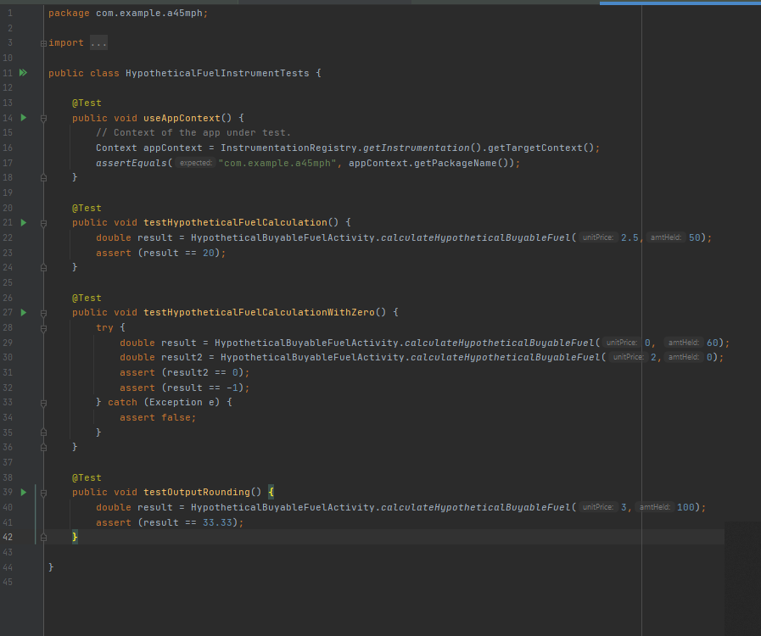
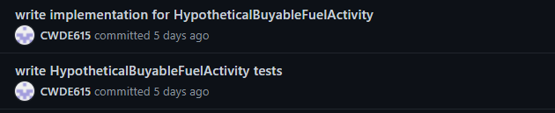
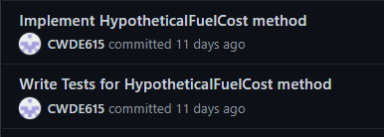
TDD Demonstration
Notes:
Kieran: Since testing is very easy in Java using the Junit framework, this team has made sure to write tests for our calculation classes and then the implementation of said classes, though there have been some slip ups. Most of the work is simple enough that only one step through the otherwise iterative process of TDD is necessary, and the number of tests rarely exceeds five. Often, we also make sure to commit the tests to the repo so that a record of the tests being written first exists there. On screen are two screenshots on the left, exemplifying this for our hypothetical fuel cost calculation, and another on the right showing what one of the test classes looks like. It should also be noted that we have not used TDD for the UX elements of our application, because we are testing those manually.

Slide 10
Project Demo
Notes:
Kieran: Now I will pass things over to Christopher for our Project Demonstration. He will show off several of the features we have implemented during the first sprint and discuss the scope of the application as it exists right now.

Slide 11

Thanks for Attending!
Notes:
Christopher: With this demonstration, we at 45mph conclude our sprint one presentation. Thank you for listening, and we hope that we’ve done a good job of communicating the work we’ve done so far as well as all the work forthcoming in our project.

